Slide 1
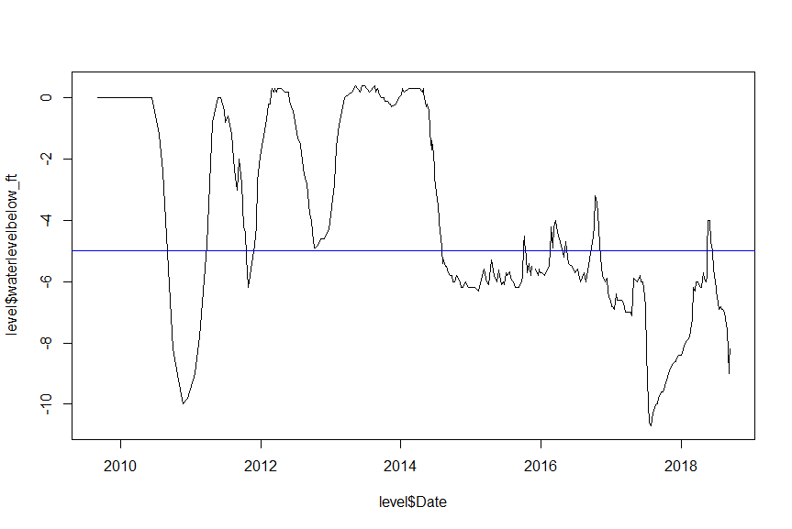
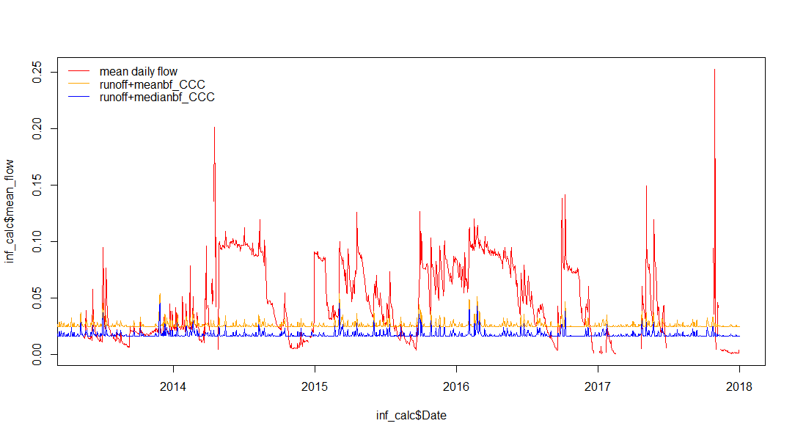
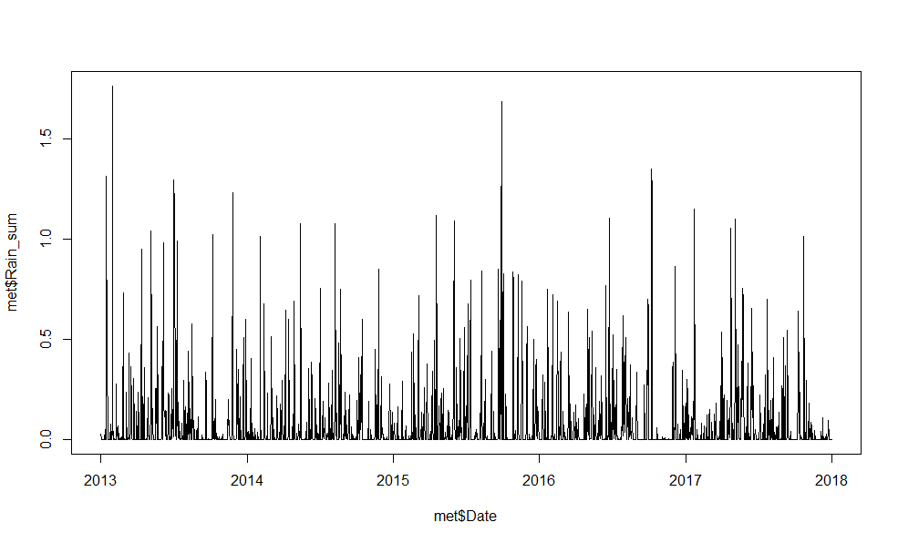

Slide 2
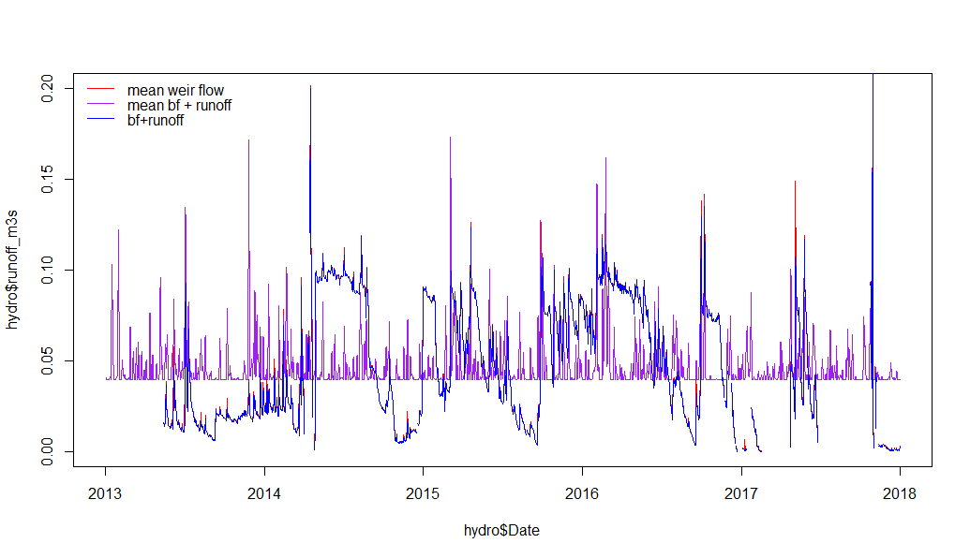
Runoff + baseflow matches the mean weir flow well!
Adding the mean bf to runoff misses some big events—these must be from BVR!
So we need a way to capture BVR dynamics
What about the big spike in 2017 when BVR was super low?

Slide 3
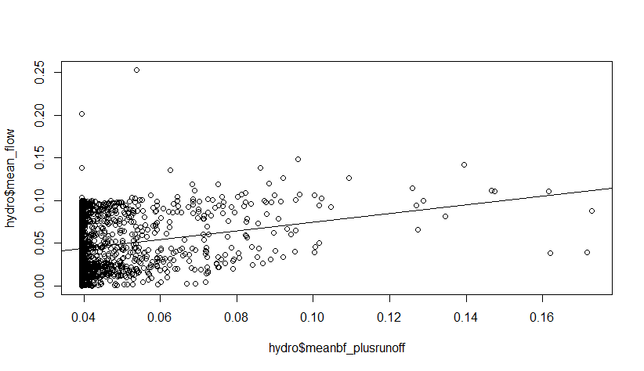
Meanbf+runoff is predictable using Nicole’s overland model
Lm of ^^ relationship:
Mean flow = 0.02356 + 0.51091*meanbf+runoff
Notes:
Log meanbf + runoff

Slide 4
Baseflow + runoff should equal inflows to the reservoir
Unless BVR is above -5ft below dam, in which case more water is being added from BVR pipe
What is the area of this pipe? We should be able to calculate how much BVR can add based on the pipe size *if* the water level is above -5ft below dam

Slide 5
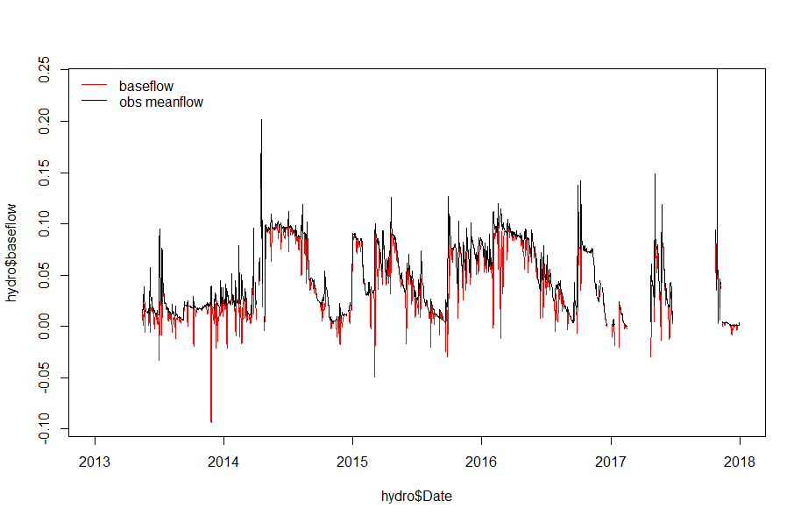
baseflow = (3.1E5/(mean_wrt*86400)) - runoff_m3s
Negative values when runoff is greater than water in reservoir (i.e., negative baseflows account for no change in reservoir water level when runoff is high)
Mean baseflow = 0.039481, median baseflow = 0.03114821

